Slide 1
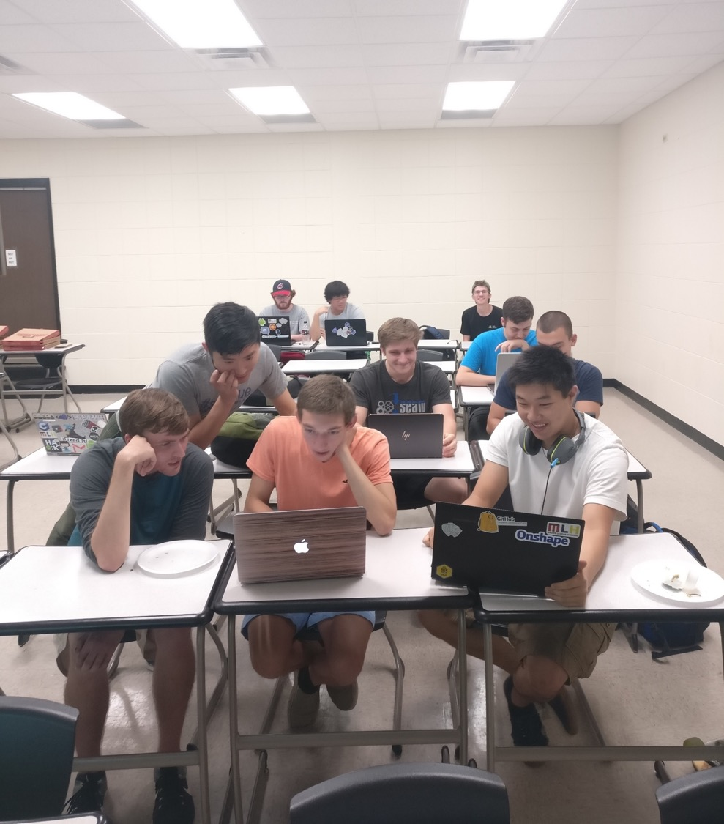



Deep Learning By Doing:
The NVIDIA Deep Learning Institute and
University Ambassador Program
www.nvidia.com/dli
Xi Chen
University of Kentucky
Lexington, Kentucky
Gregory Gutmann
Tokyo Institute of Technology
Tokyo, Japan
Joe Bungo
Deep Learning Institute,
NVIDIA Corporation
Nov 19, 2018

Slide 2
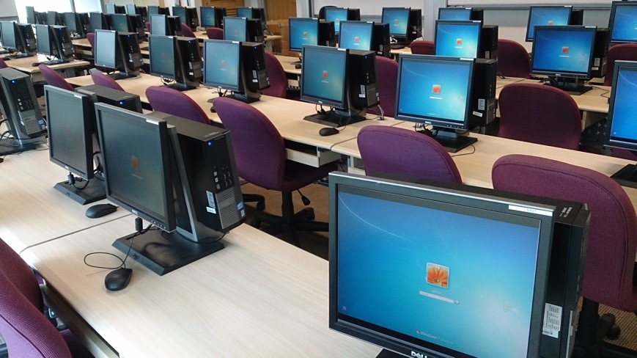
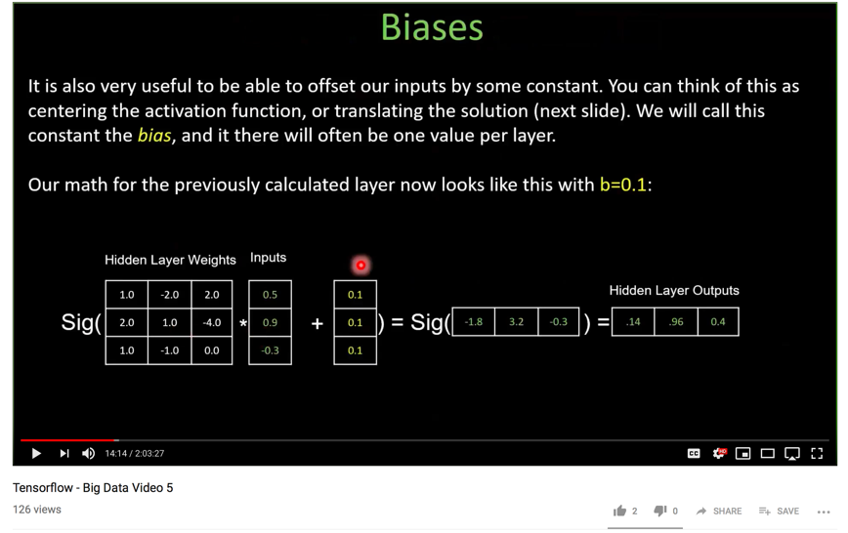
Traditional HPC courses
Locations are limited to computer labs or HPC center
Delivery methods are limited to video courses

Slide 3
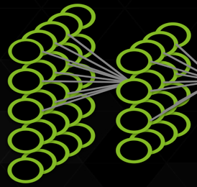
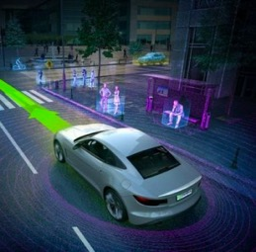


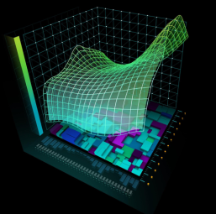
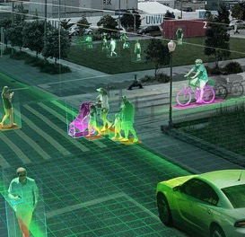

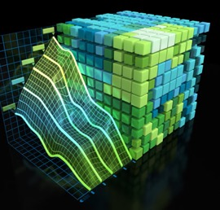





NVIDIA DEEP LEARNING INSTITUTE
Hands-on self-paced and instructor-led training in deep learning and accelerated computing for developers
Request onsite instructor-led workshops at your organization: www.nvidia.com/requestdli
Take self-paced labs online: www.nvidia.com/dlilabs
Download the course catalog, view upcoming workshops, and learn about the University Ambassador Program: www.nvidia.com/dli
Deep Learning Fundamentals
Autonomous Vehicles
Medical Image Analysis
Genomics
Finance
Intelligent Video
Analytics
More industry-specific training coming soon…
Game Development & Digital Content
Accelerated Computing Fundamentals
Notes:
The NVIDIA Deep Learning Institute (DLI) offers hands-on training for developers, data scientists, and researchers looking to solve challenging problems with deep learning and accelerated computing. DLI courses are designed to help you get started with training, optimizing, and deploying neural networks to solve real-world problems across diverse industries such as autonomous vehicles, healthcare, media & entertainment, intelligent video analytics, finance, and more. You get experience using the latest AI frameworks, SDKs, and GPU-accelerated technologies on fully-configured GPU servers in the cloud.
DLI courses are offered in two formats:
In-person workshops led by a DLI certified instructor are available around the world and can be requested onsite at your location.
Visit the DLI page at www.nvidia.com/dli place your order.
Self-paced online labs that can be accessed at any time from anywhere. Visit www.nvidia.com/dlilabs to get started today.
To support qualified educators teaching deep learning in the classroom, the DLI University Ambassador Program allows university instructors to teach DLI courses to students and faculty at their university. The program includes access to DLI Teaching Kits for Deep Learning, Robotics, and Accelerated Computing. These kits offer complete course solutions including lecture slides, hands-on labs, and exams.

Slide 4
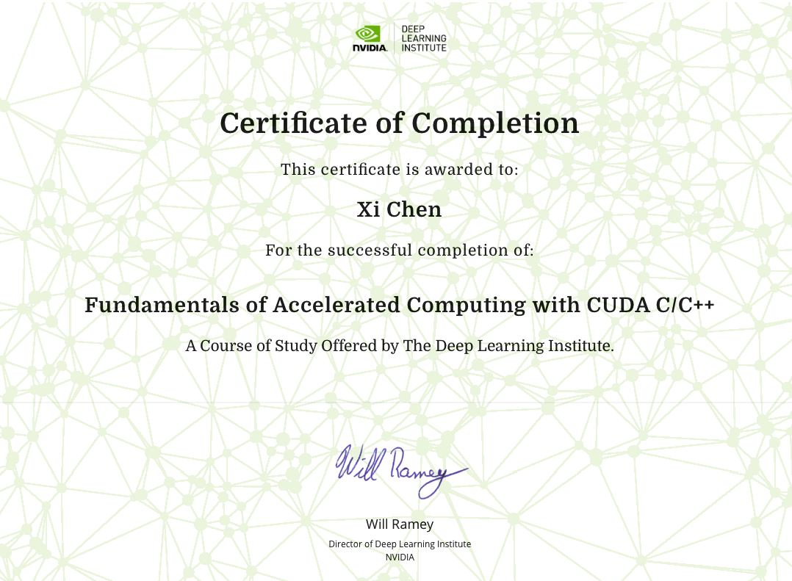
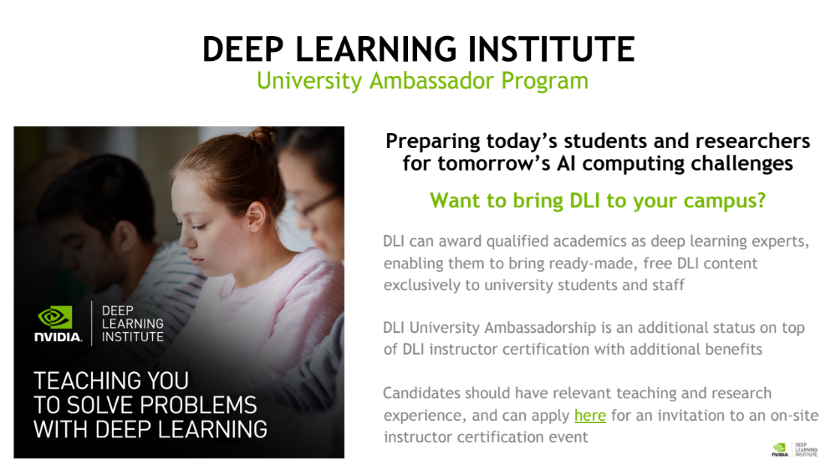
Certificate of Competency
After students finish the course and pass the assessments, they will receive a certificate of course completion.
Every certification has a unique identification number and online hyperlink, and is tied directly to the student. Students are actively linking their certifications from their resumes and LinkedIn profiles.
At the time of this writing, there are no other hands-on, project-based assessment and certification programs in applied deep learning.
Student’s Name

Slide 5
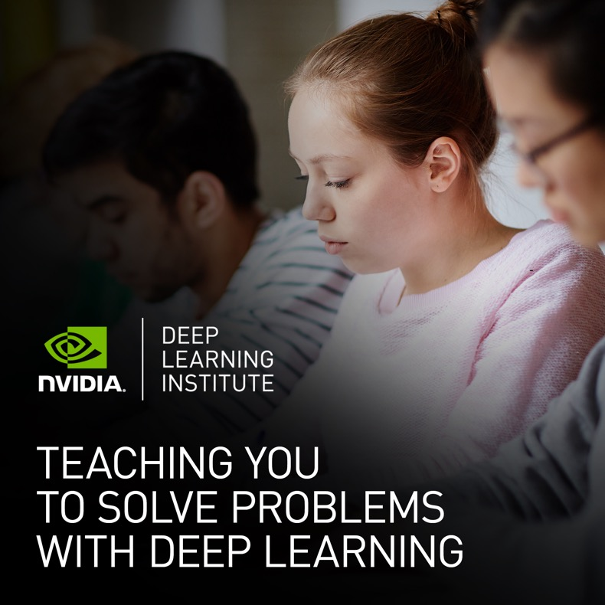
DEEP LEARNING INSTITUTE
University Ambassador Program
Preparing today’s students and researchers for tomorrow’s AI computing challenges
Want to bring DLI to your campus?
DLI can award qualified academics as deep learning experts, enabling them to bring ready-made, free DLI content exclusively to university students and staff
DLI University Ambassadorship is an additional status on top of DLI instructor certification with additional benefits
Candidates should have relevant teaching and research experience, and can ask Joe Bungo for more details

Slide 6















INSTITUTIONS WITH AMBASSADORS
DLI has awarded 150+ certified Ambassadors globally
Over 150 workshops delivered in less than a year since 2017
Ambassadors (and non-Ambassadors) have included DLI course materials in their own syllabi

Slide 7







Educational Strategies
By combining teaching and interaction with instructor and hands-on practice, learning promotes self- discovery and self-appropriate. which leads to future application.
Hands-on experiences also provide an immediate feedback assessment technique that allows students to receive immediate results that assess their knowledge
Teaching
Interaction
Hands-on
Learning
Self-discovery
Self-appropriate

Slide 8
Educational Strategies
Teaching
Interaction
Hands-on
By combining teaching and interaction with instructor and hands-on practice, learning promotes self- discovery and self-appropriate. which leads to future application.
Hands-on experiences provide an immediate feedback assessment technique that allows students to receive immediate results that assess their knowledge
Learning
Self-discovery
Self-appropriate

Slide 9
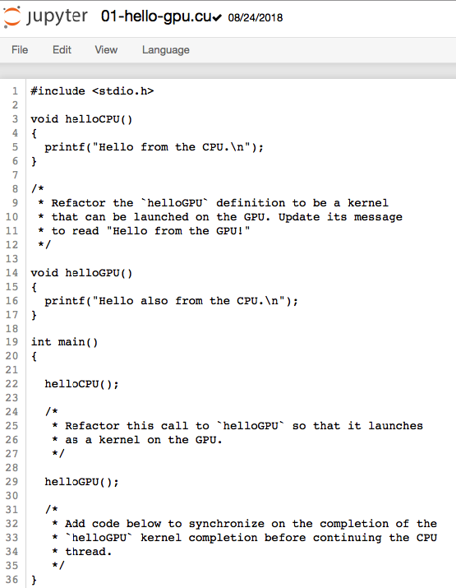
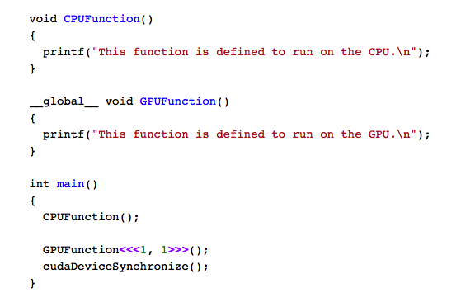
Hands-on Experiences Facilitate Learning
Teaching
Interaction with Instructor
Hands-on

Slide 10

The __global__ keyword indicates that the following function will run on the GPU, and can be invoked globally, which in this context means either by the CPU, or, by the GPU.
Notice the return type void. It is required that functions defined with the __global__ keyword return type void.
Expected output
Students were asked to practice by changing the CPU function to GPU kernel
When calling a function to run on the GPU, we call this function a kernel, which is launched.
we must provide an execution configuration, which is done by using the <<< ... >>> syntax just prior to passing the kernel any expected arguments.
Students also need to add codes that allow kernel run on GPU.
Unlike much C/C++ code, launching kernels is asynchronous: the CPU code will continue to execute without waiting for the kernel launch to complete.
Teaching
Interaction with Instructor
Hands-on

Slide 11
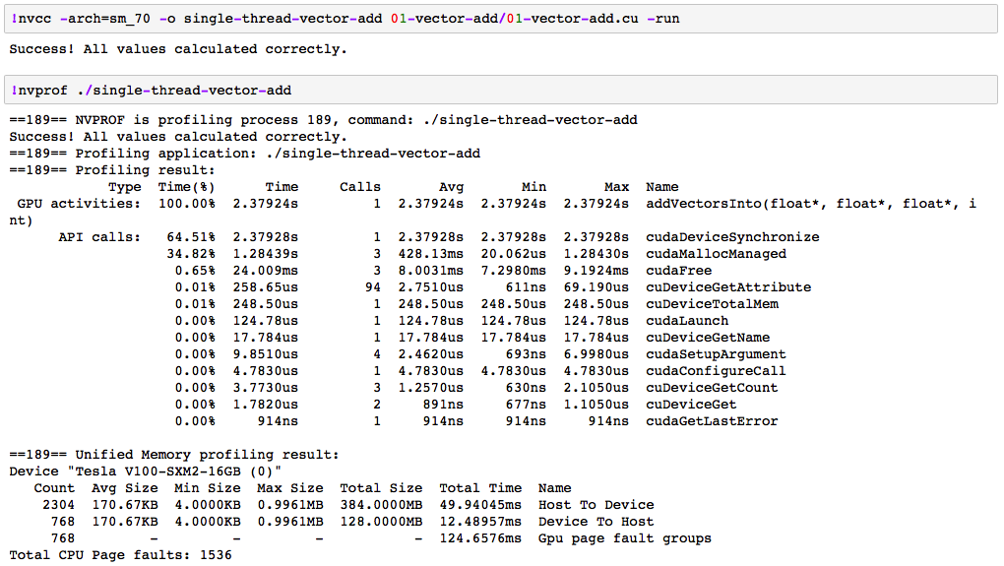
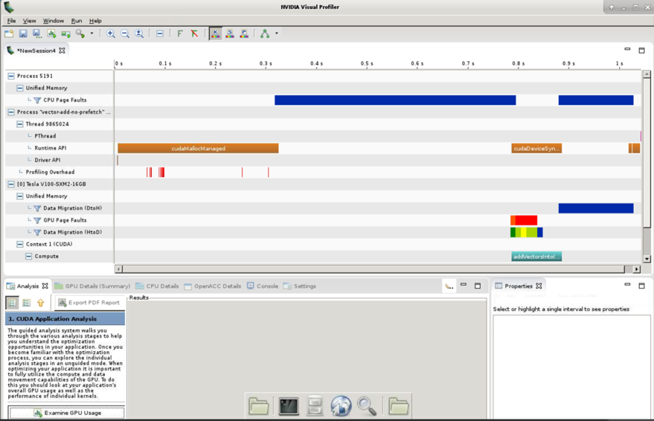
Immediate Feedback Assessment
Profiling Result
Unified Memory
CUDA compute
Unified Memory Profiling Result

Slide 12
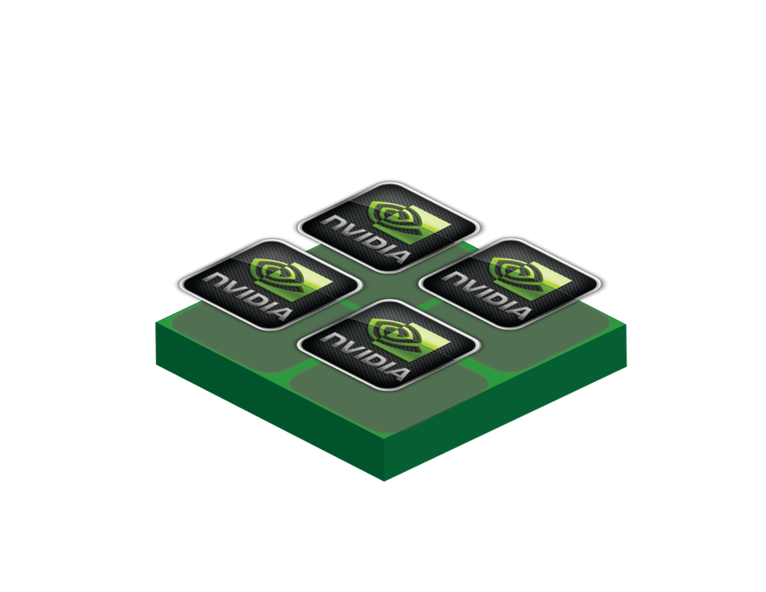
Reproducibility
Notes:
reproducibility of the processes and resources

Slide 13
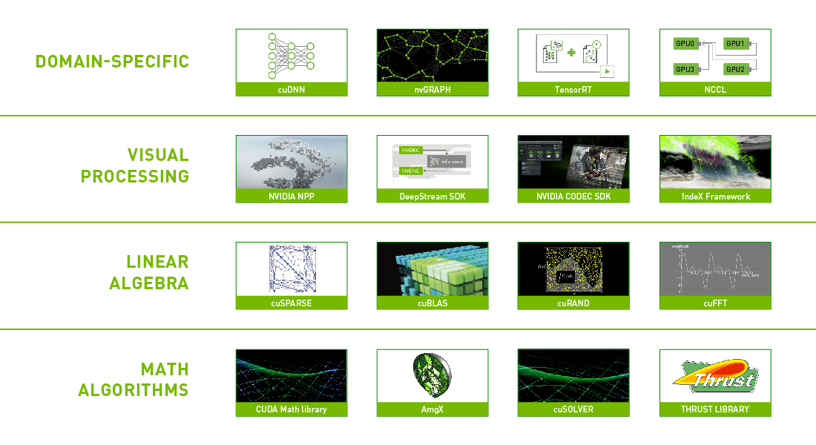
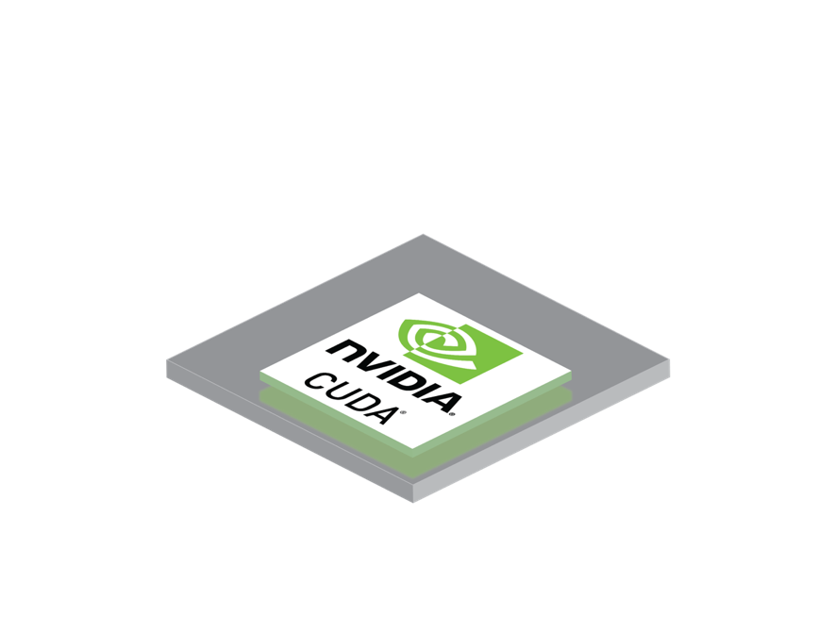
Reproducibility
Notes:
reproducibility of the processes and resources

Slide 14

Reproducibility
Notes:
reproducibility of the processes and resources

Slide 15

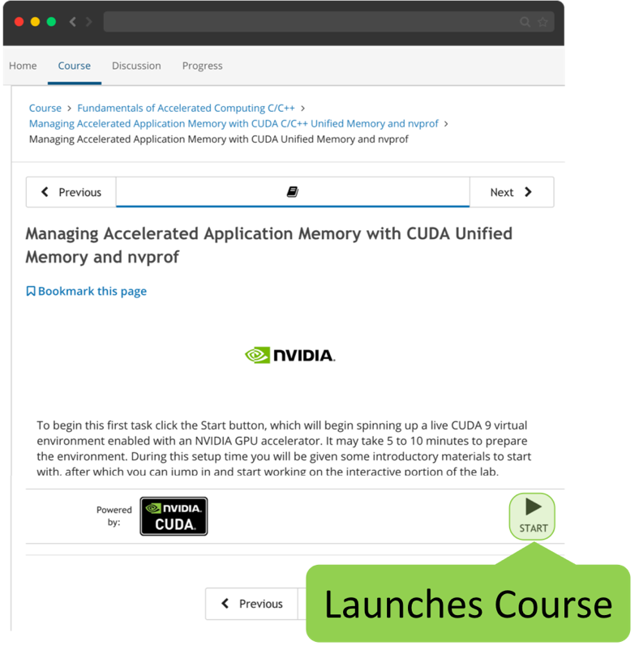
…
Reproducibility
Notes:
reproducibility of the processes and resources

Slide 16
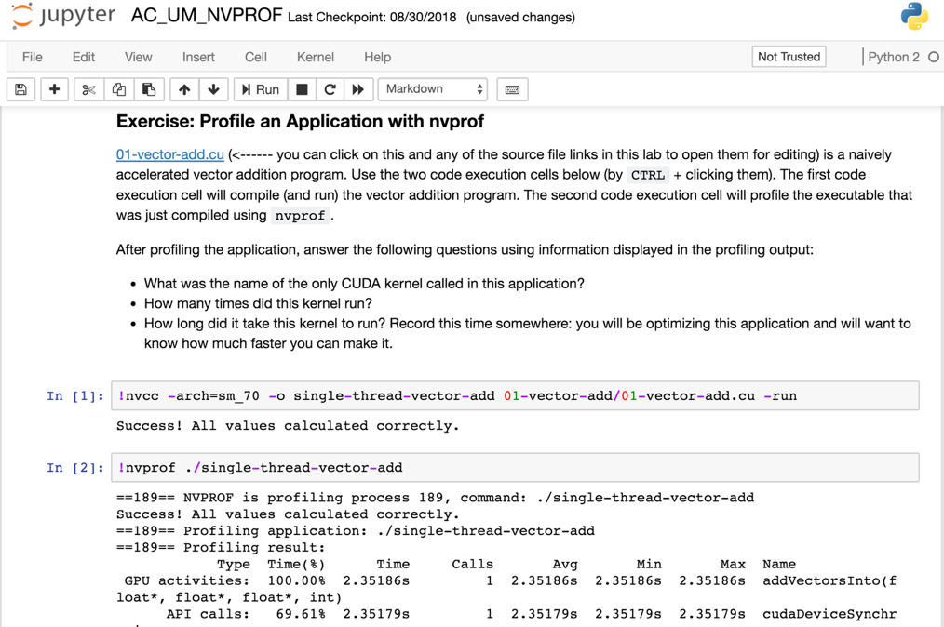
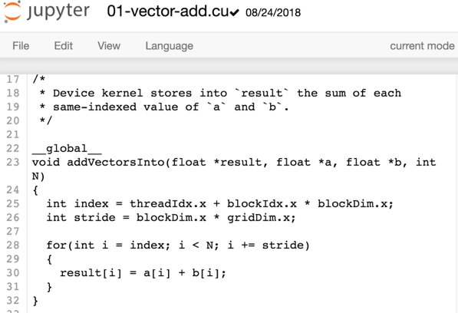
Link to Code Editor
Code Editor

Slide 17

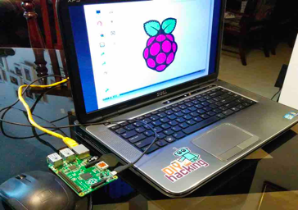


NVIDIA DLI Courses could be used in:
where a standard teaching outcome is expected.
where computing resources are limited.
where programming environment requires special setup.
where software or hardware dependence is an issue.
Notes:
situations for which it is relevant or in which it was applied

Slide 18
Outcome of Recent DLI Courses
At UC Berkeley, DLI course contents were included into the curricular.
At National Tsing Hua University, DLI course materials were integrated into teaching activities.
At KLE Technology University in India, several DLI training events were conducted and the feedback from students continues to be positive and favorable,
At Tokyo Institute of Technology, Prof. Gutmann (author of the paper) conducted a pilot workshop using the CUDA illustrated the benefit of DLI on various host machines and operating systems.
At University of Kentucky, the Association for Computing Machinery UK chapter also conducted the DLI courses. Students was amazed by the simplicity and easiness of HPC GPU programming via DLI platform.

Slide 19

Fundamentals of Accelerated Computing C/C++ Course Feedback
How helpful or unhelpful is your instructor?
86%
Extremely
Helpful
14%
Moderately
Helpful
How easy or difficult is it to navigate the course platform?
58%
Extremely
Easy
14%
Moderately
Easy
14%
Slightly
Easy
14%
Neither Easy Nor Difficult
How useful are the information provided from the course?
71%
Extremely
Useful
29%
Moderately
Useful

Slide 20




Thank You

