Slide 1
Accelerating the Signal Alignment Process in Time Evolving Geometries using Python
Vinay B. Ramakrishnaiah
Zachary K. Baker
11/12/2018
LA-UR-18-30512

Slide 2
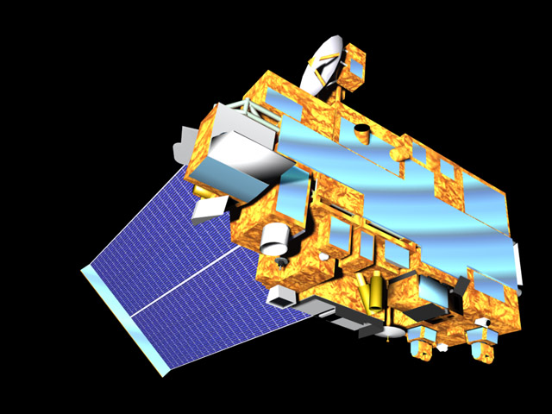
Introduction
Space borne radiometers
  Constrained by antenna size
  Not capable of achieving desired spatial resolution
Use multiple radiometers
  Dynamic beamforming arrays (DBAs)
    Large synthetic aperture
    Improves signal-to-noise ratio with directed beams
    Reduces co-channel interference
    Alleviates effect of jammers
    Improve effectiveness of small remote sensing satellites
NASA Visible Earth: Terra Satellite

Slide 3
Motivation
Typically radio frequency (RF) DBAs
  Depend on precise metrology and synchronized clocks
    Increases the size, weight, cost, and power consumption
Efforts to relax precision using post processing techniques
  Search across a range of all possible:
    Orientations
    Relative positioning
    Direction of travel
  Align the collection of signals
Synthesis of coherent sparse arrays
  Time and position using a cheap commercial GPS receiver

Slide 4
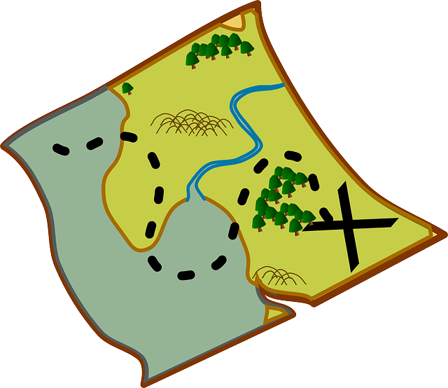
Coherent Collection
Copy and retransmit
Transmitted signal collected using multiple collectors
Downlinked and post-processed to estimate parameters
Signal aligned during post-processing
Emitter
Ground station aligns and reassembles record
Ground Station
Mapping
RF copy

Slide 5
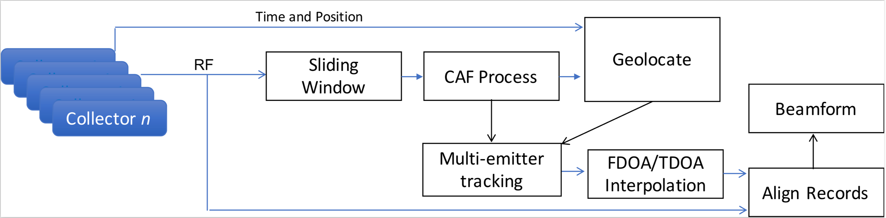
Signal Alignment
Alignment stage follows signal collection
  Cross Ambiguity Function (CAF) used for performing correlation searches
  Search over all possible time differences of arrival (TDOA) and frequency differences of arrival (FDOA)

Slide 6
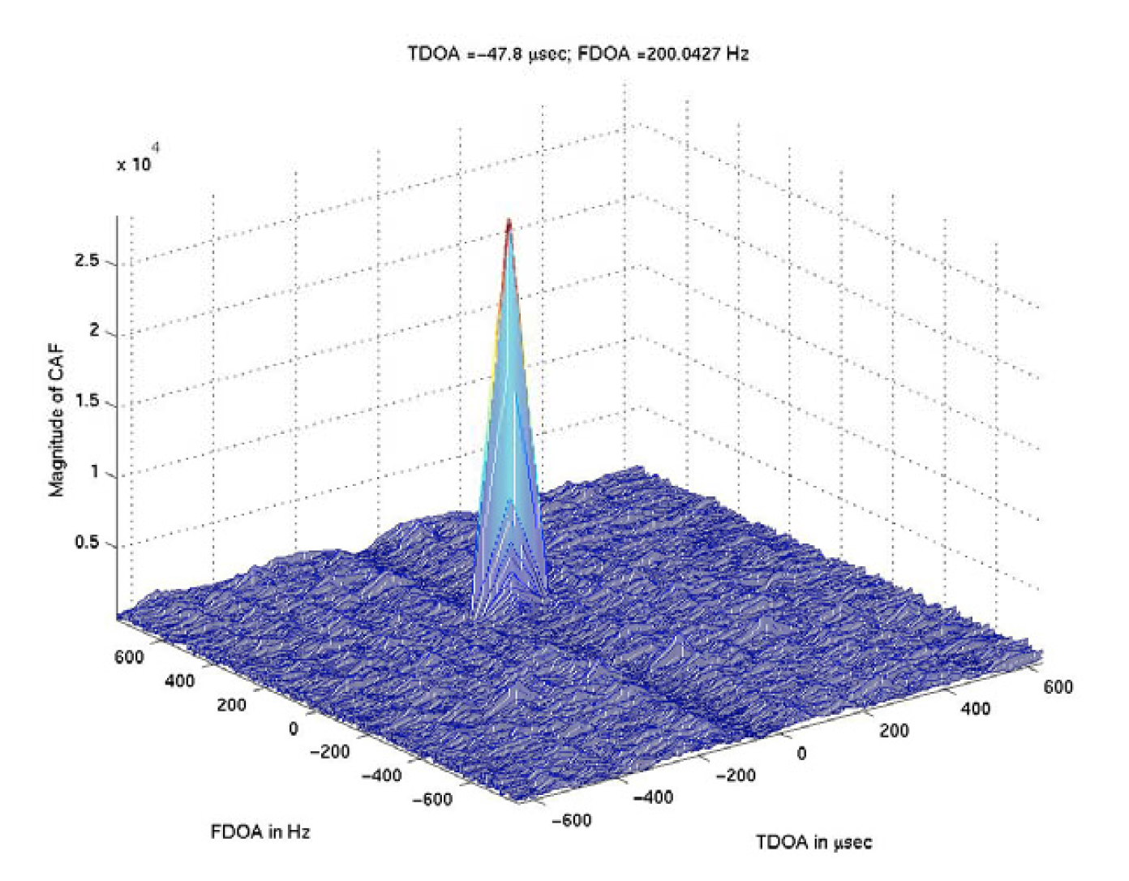
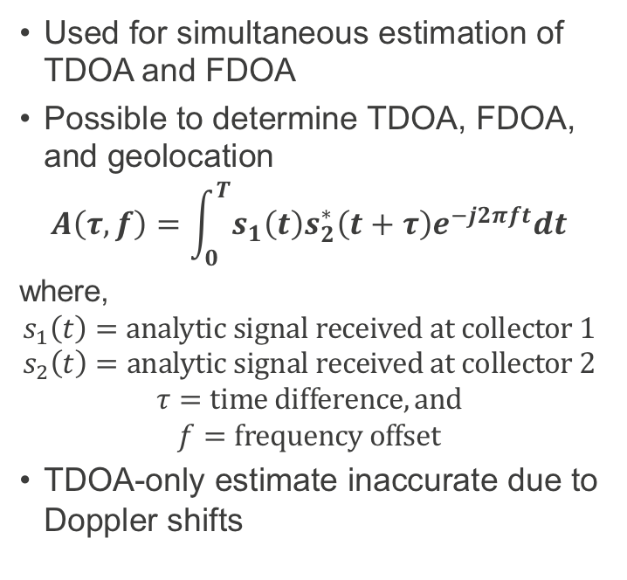
Cross Ambiguity Function (CAF)
Used for simultaneous estimation of TDOA and FDOA
Possible to determine TDOA, FDOA, and geolocation
$$A\left(τ, f\right)=\int_{0}^{T}{s_{1}\left(t\right)s_{2}^{∗}\left(t+τ\right)e^{−j2πft}dt}$$
where,
$$s_{1}\left(t\right)=analytic signal received at collector 1$$
$$s_{2}\left(t\right)=analytic signal received at collector 2$$
$$τ=time difference, and$$
$$f=frequency offset$$
TDOA-only estimate inaccurate due to Doppler shifts
Notes:
CAF is a correlation function
Takes frequency and time offset as independent variables
Peaks when the values match the inherent offset embedded in the signal due to geometry of the collectors and the emitter

Slide 7
Advantages of using CAF
Allows to have relaxed constraints on metrology
Eliminates the need for shared clocks
For narrow-band signals
  Time offset also includes ionospheric delay along with range delay
  Ionosphere and other sources of noise are difficult to predict
  Are all compensated for in the CAF based approach
Neither requires demodulation nor understanding
  Except for some estimate of the signal bandwidth

Slide 8
Python Implementation
Implemented in Python for ease of development
  Easy to interface with other programming languages
CAF can be realized using a complex multiplication and a Fast Fourier Transform (FFT).
  Implemented using NumPy
FFT is a faster way to compute the Discrete Fourier Transform (DFT).
  Computational complexity of O (N log N)
  Better at processing a batch of discrete signals
  For higher resolutions increase the number of points

Slide 9
Python Implementation
With coherent collection, have an estimate of the range of signal frequencies
  Use multiple passes of the Fourier transform
  Initially, use FFT to get a coarse estimate
  “Zoom in” around the coarse estimate using DFT
    Refine the FDOA estimate
Overall computations are reduced

Slide 10
Challenges
Difficult to maintain alignment over a longer time span
  Requires an evolving model of collector geometry
  Addressed through overlapping sequential CAF
  Estimate the evolving TDOA/FDOA
Computation time was a million times slower than real time

Slide 11
Objective
Explore parallelism and optimization techniques to speed-up CAF computations
  Vectorization
  Armadillo C++ implementation
  Distributed memory parallelism
    Parmap
    Dask
    MPI4Py
  Shared memory parallelism
    ArrayFire

Slide 12
Vectorization
Explicit looping structures
  Very slow in Python compared to its low language counterparts
Vectorization
  Absence of explicit looping and indexing
  Take advantage of optimized pre-compiled code offered by various packages
NumPy: interface to C/C++ functions
  Python stack built on top of OpenBlas
  Fast operation on homogeneous data types
Python CAF code
  TDOA and FDOA are searched across different time and frequency values
  Instead of running loops to search
    Vectorize the inner loop
    Requires redundant repetition of elements

Slide 13
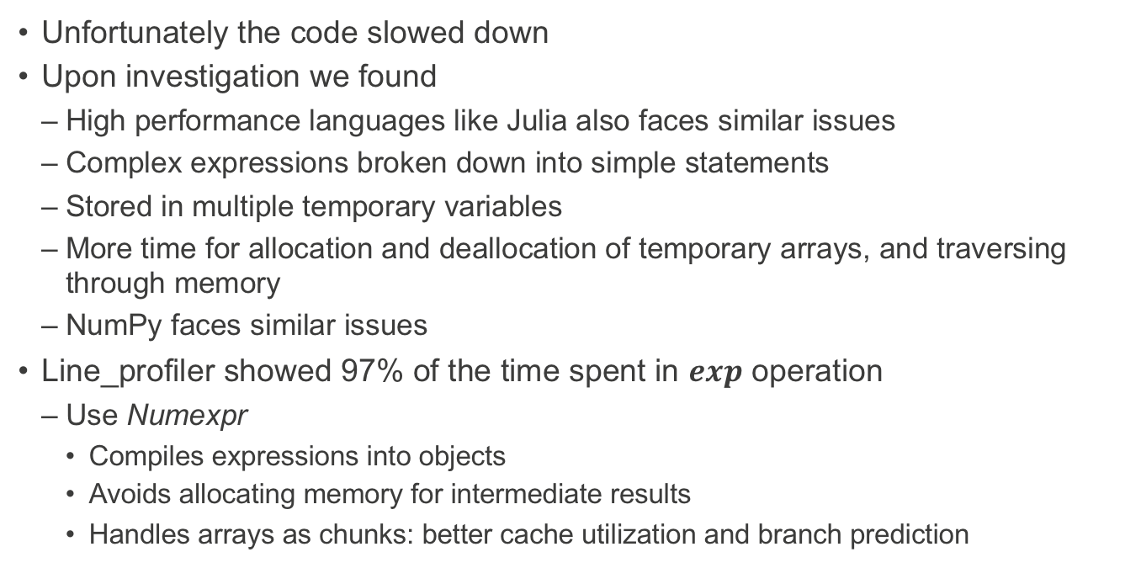
Vectorization Results
Unfortunately the code slowed down
Upon investigation we found
  High performance languages like Julia also faces similar issues
  Complex expressions broken down into simple statements
  Stored in multiple temporary variables
  More time for allocation and deallocation of temporary arrays, and traversing through memory
  NumPy faces similar issues
Line_profiler showed 97% of the time spent in $exp$ operation
  Use Numexpr
    Compiles expressions into objects
    Avoids allocating memory for intermediate results
    Handles arrays as chunks: better cache utilization and branch prediction

Slide 14
Vectorization
4x
Hardware: Intel Haswell CPU (E5-2660_v3)
Notes:
Numexpr: sped-up the vectorized code by approximately a factor of 4

Slide 15
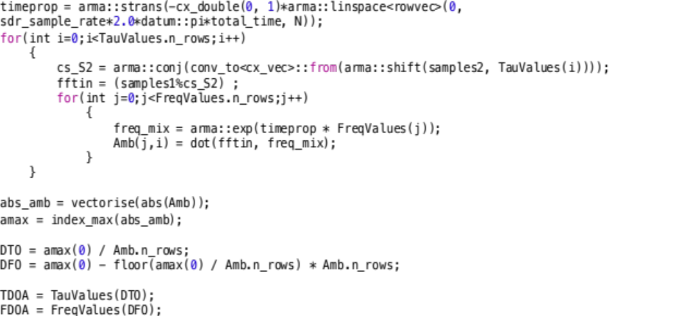
Armadillo C++ implementation
Performance comparison: Optimized NumPy and Armadillo C++
Armadillo:
  C++ linear algebra library
  High level syntax and functionality similar to Matlab
  Supports sparse and dense matrices
  Uses LAPACK and BLAS
  OpenMP multithreading for expensive operations
Armadillo C++ kernel of CAF.

Slide 16
Armadillo C++ implementation
7x

Slide 17
Distributed Memory Parallelism
Break the long signal into successive, overlapping frames
  Estimate signal parameters
Explored different distributed computing libraries for python
  Parmap:
    Small module with only 4 functions
    Creates a pool for parallel computations
    Wrapper for launching multiple processes on a single node
  Dask:
    Parallel solution for NumPy arrays and Pandas Dataframe objects
    Dynamic task scheduling
    Datatypes for processing vectors and matrices in parallel
    ‘dask-ssh’ to open several SSH connections to target computers in the cluster
    Dask workers launch via MPI or SSH, use TCP/IP for transferring pickled data structures

Slide 18
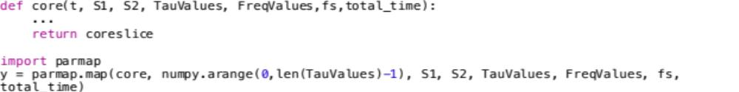
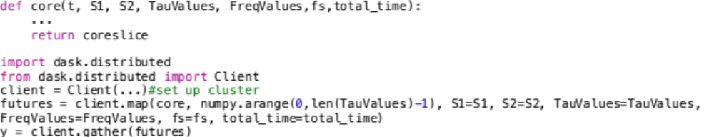
Distributed Memory Parallelism
(a) Distributed computing using Parmap.
(b) Distributed computing using Dask.

Slide 19
MPI execution time for 32K points using Dask
Parmap provided similar performance as Dask on a single node
Notes:
12x improvement in performance compared to non-vectorized numpy

Slide 20
Distributed Memory Parallelism
Search for CAF parallelized
  Distribute the computations at different time offsets
  12x faster than the non-vectorized NumPy version for 32K points
  Equal distribution of work on heterogenous nodes creates imbalance
    Slowest MPI process is the bottleneck

Slide 21
Shared Memory Parallelism
Shared memory parallelism in Python is difficult to achieve
  Global Interpreter Lock (GIL) limits Python interpreter to one running thread
Problem mitigated by calling multi-threaded C/C++ functions
Our NumPy is multi-threaded (OpenBlas)
  Tried using Intel Math Kernel Library (MKL), no significant improvement

Slide 22
Shared Memory Parallelism
Improve on-node performance
Target heterogeneous nodes
  Use ArrayFire (AF)
ArrayFire:
  General-purpose, open-source library
  Accelerated, scalable computing solution
  Targets parallel and massively parallel architectures
  CUDA, OpenCL, and CPU backends
Accelerated versions of NumPy functions
Parallelized the computation of dot product for DFT, conjugates, shift, and FFT operations using AF
@broadcast function decorator to asynchronously compute ambiguity values

Slide 23
AF implementation on NVIDIA GTX TITAN X

Slide 24
Non-vectorized ArrayFire code on different GPU architectures (32K points)
Notes:
17x improvement compared to the serial code run on Intel Haswell CPU

Slide 25
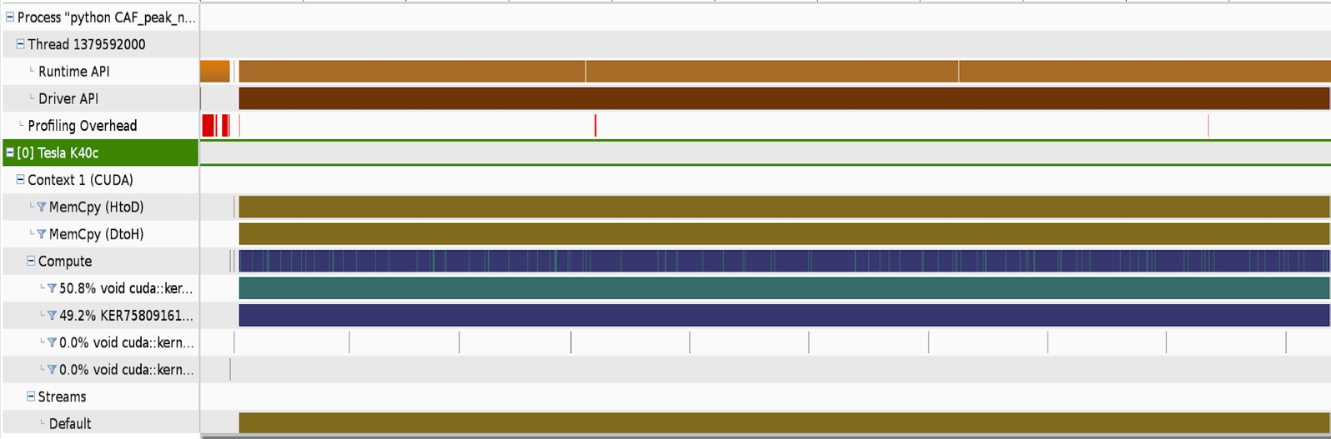
GPU profile of the non-vectorized code using NVIDIA visual profiler
Notes:
AF uses JIT and lazy evaluation strategy. Therefore, using vectorized code is beneficial.

Slide 26
Vectorized ArrayFire code on different GPU architectures (32K points)
150x

Slide 27
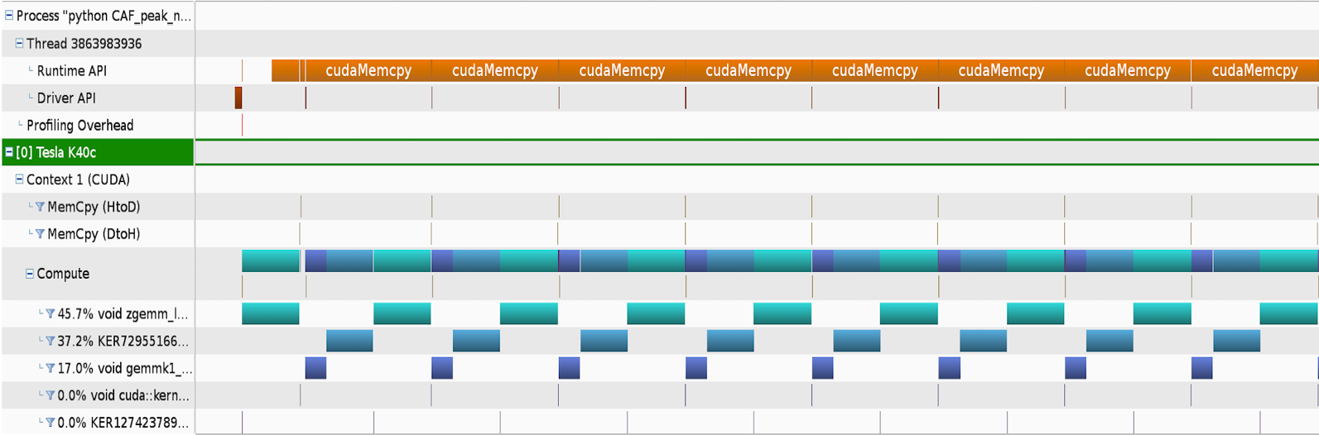
GPU profile of the vectorized code using the NVIDIA visual profiler

Slide 28
Load Balancing on Heterogeneous Nodes
Load balancing scheme using MPI4Py
  MPI4Py
    Python bindings of the MPI standard for Python
    Object oriented interface
    Supports point-to-point and collective communications
  MPI master-worker task queue
  Suitable for running on heterogeneous architectures
Outer time loop distributed using MPI4Py
Fixed size problem: signal of sample size 16K points
CAF computations on 4 nodes
  2 nodes: NVIDIA Titan X
  2 nodes: NVIDIA Tesla K40c
Record the number of time-samples handled by each node

Slide 29
Load balancing on nodes with different GPU architectures.
The load balancing fractions approximate the speedups between the GPU types.

Slide 30
Summary
RF DBAs from multiple free flying collections is challenging
  Relies on precise metrology and synchronized clocks
Efforts focused on relaxing precise measurements
  Uses post processing on ground
  Drawback: Long signals take untenable computational times on a CPU
NumPy implementation ~ Armadillo C++ implementation
MPI using Dask (also Parmap on single node): ~12x improvement
Shared memory parallelism using AF: ~150x improvement
Load balancing using MPI4Py for heterogenous clusters
  MPI+X solution

Slide 31
References
[1] Hartwell, Glenn D. Improved geo-spatial resolution using a modified approach to the complex ambiguity function (CAF). Diss. Monterey California. Naval Postgraduate School, 2005.
[2] Moss, Andrew. Temporally adjusted complex ambiguity function mapping algorithm for geolocating radio frequency signals. Diss. Monterey, California: Naval Postgraduate School, 2014.
[3] Baker, Zachary K., Nicholas Dallmann, and William Junor. Aperture Synthesis from Free-flying Collectors without Accurate Metrology.

Slide 32
Thank you!
Questions?

Slide 33
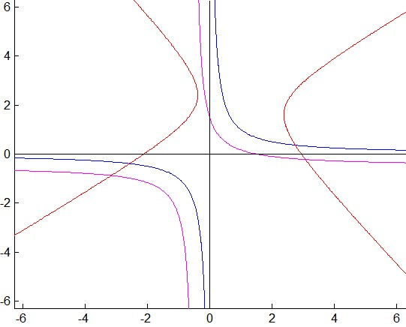
TDOA geolocation
Emitter
Collector 1
Collector 2
Emitter is on the set of points such that the difference of time between the received signals by the two collectors is constant

Slide 34
FDOA geolocation
FDOA: Doppler differential due to relative motion
Emitter location estimated:
  Known observer location
  Velocity vectors
  Relative doppler shifts

Slide 35
CAFMAP Geolocation
Hartwell et al. [1] developed the CAFMAP algorithm
  Divide area into grids, precompute CAF at each grid location, look for a match
  Relies on constant signal parameters
  Assumes constant collector-emitter geometry over signal collection
Reality: Collector-emitter geometry evolves in time
Moss et al. [2] overcome this limitation
  Let $τ and f$ be a function of time
  Accurate but computationally complex

Slide 36
Computational complexity
Complexity $\sim O(N^{3}log⁡(N))$
Long times for computations
Limits the algorithm for shorter duration of signals

Slide 37
Parallelization
Simultaneously perform multiple operations to reduce processing time
Major operations in CAF:
  Complex conjugation
  Shift operation
  Fourier transform
These operations can be parallelized
In addition, processing is independent for each $τ and f$

